Slide 1

Banking Basics!

Slide 2

Why The Bank?
Banks and credit unions are safe and convenient places to keep your money.
Most account balances are insured up to $100,000 by the Federal Deposit Insurance Corporation (FDIC).
Banks are for-profit.
How do they earn money?
Credit Unions are non-profit.
Owned and controlled by their members

Slide 3

Savings Accounts
Your money earns interest, which is a return on your money.
Annual Percentage Rate (APR) is the amount your money would earn if left on deposit for one year.
Savings accounts usually carry an APR of 1% or 2%.
Example: @ an APR of 1%,
$1,000 would earn $10 in a year

Slide 4

Types of Interest
Simple Interest: determined by initial deposit only.
Compound Interest: you earn interest on your initial deposit as well as on the interest you earn.
Compound interest is better!

Slide 5
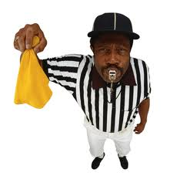
Certificates of Deposit (CDs)
Offer a guaranteed interest rate for a specified amount of time.
You choose the length of time that your money is deposited (months to years)
The longer the term, the higher the interest rate
If you withdraw money early,
you will pay a penalty

Slide 6
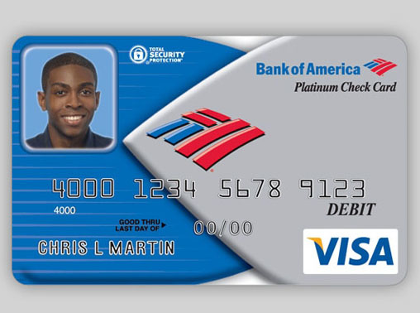
Checking Accounts
Let you deposit and withdraw money and write checks to pay for purchases and bills.
Check Card: allows you to withdraw cash, make deposits at ATM’s, and pay for purchases
PIN: Personal Identification Number

Slide 7
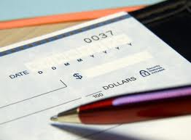
Types of Checking Accounts
Free Checking
No monthly fees
No minimum balance requirements
Student Accounts
No or low minimum balance requirements
Joint Accounts
Allow co-owners to have equal access to the account

Slide 8
Overdraft Protection
Bouncing A Check or Overdrafting: making a purchase that exceeds what you have in your account
You will pay a fee to the business ($30+), as well as a fee to your bank ($20+)
Hurts your credit with the bank
Overdraft Protection: banks will honor your check or check card purchases even if they exceed your account balance
You pay a fee to the bank for each overdraft ($10 - $20)

Slide 9
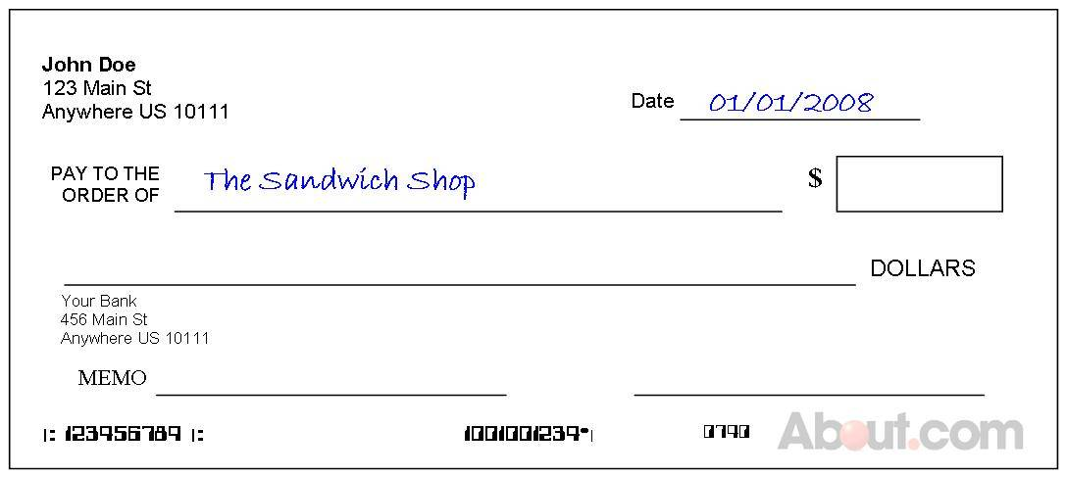
Writing A Check
Write the current date, and the name of the business or person you are making the check out to.

Slide 10
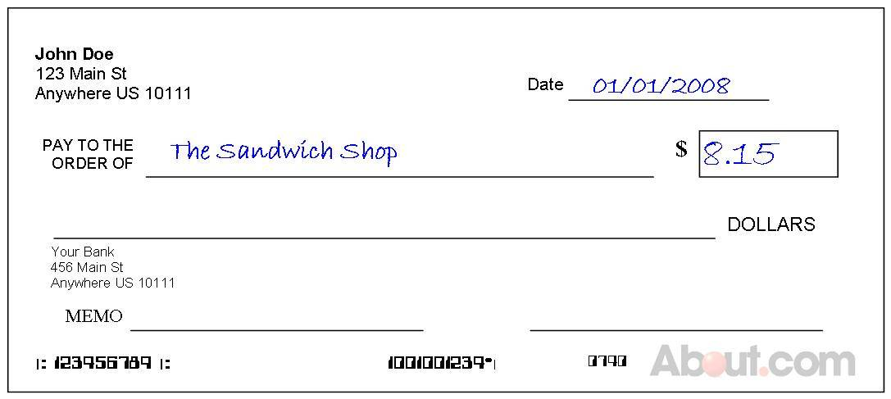
Writing A Check
Write the amount of your payment in the small box. Start as close to the left as possible, so numbers cannot be added.

Slide 11
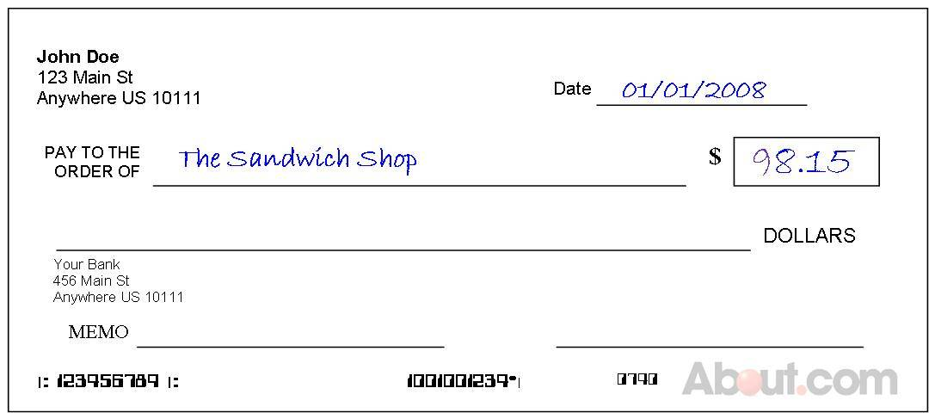
Writing A Check
Someone could easily add a number if space is left before the amount you wrote!

Slide 12
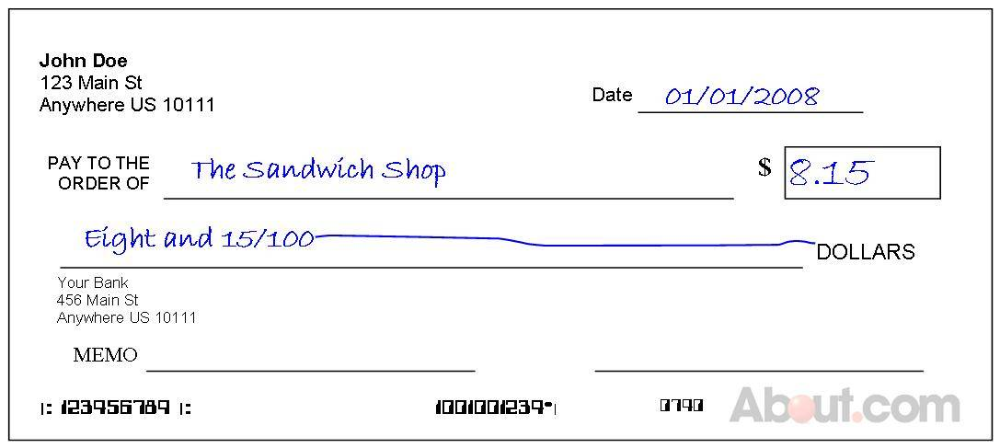
Writing A Check
Dollars are written out. Cents are shown as a fraction out of 100.
Immediately after you write out the amount, draw a line all the way over to the word "DOLLARS". This makes it harder for anybody to write something else in that space.

Slide 13
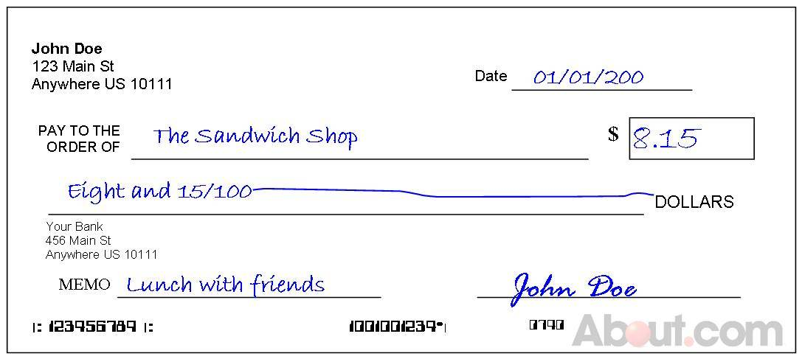
Writing A Check
Fill in the memo line to remind yourself what the check was written for.
Sign your check legibly with the same signature that is on file at the bank.

Slide 14
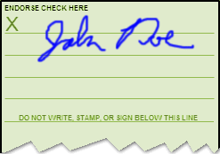
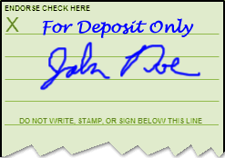
Endorsing A Check
Blank Endorsement: sign your name, just as it appears on the front of the check, on the top line. This can be used to cash the check, deposit it, or give it to someone else for him to cash or deposit it.
Include the phrase "For deposit only” above or below your signature, if you plan to deposit your check.

Slide 15
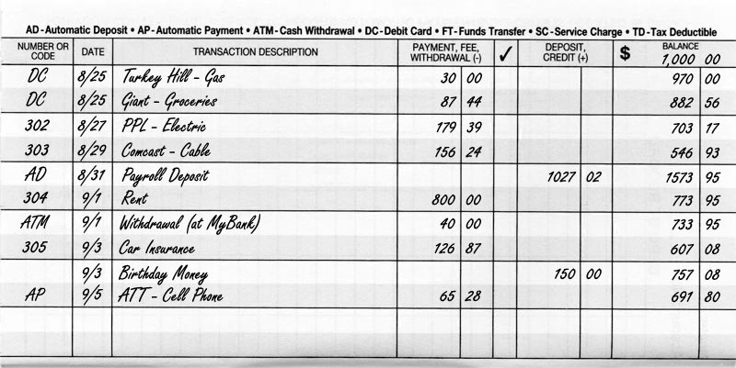
Filling Out The Checkbook Register
1
2
3
4
5
6
7
1: Check Number or Code 4: Payment/Debit
2: Date 5: ✔ Payment has been processed
3: Transaction Description 6: Deposit/Credit
7: Running Balance

